Slide 1
Smart sanitary pad bin
Mahilnila P & Mahalakshmi R
KG college of arts and science.
II B.Sc.IT
Project description: A Smart Sanitary Pad Bin is an automated disposal system designed to ensure hygienic and odor-free management.

Slide 2
Why We Are Implementing This Idea
We are implementing the Smart Sanitary Pad Disposal Alert System to solve an important hygiene and waste management problem.
In many public places like: Schools, Colleges, Offices, Hospitals…Sanitary pad disposal bins are not monitored regularly.
When the bin becomes full: It causes bad smell. It creates unhygienic conditions. It spreads bacteria and infections. It causes embarrassment and discomfort for women.
So we thought of a smart solution.

Slide 3
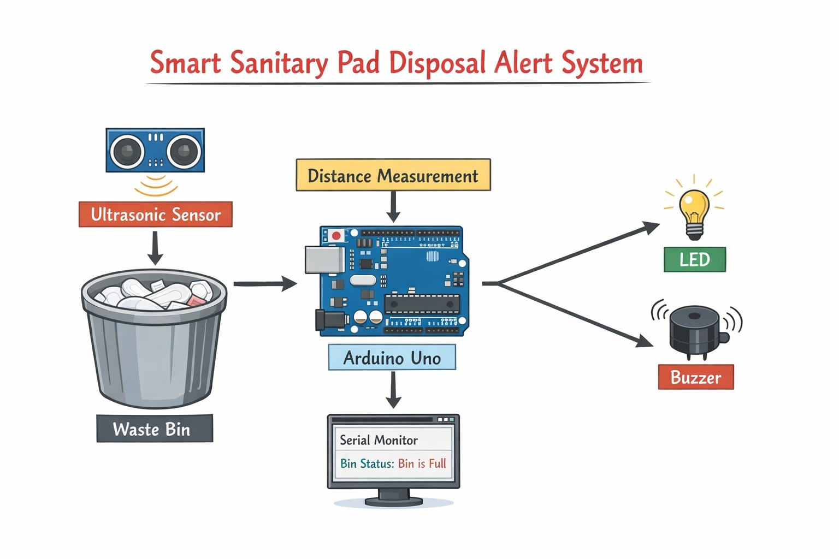
HOW IT WORKS
Waste Goes Inside the Bin
Sensor Measures the Level
Arduino Checks the Distance
Alert is Given:
Depending on the level:
LED glows
Buzzer sounds
Message is displayed
.

Slide 4
THANK YOU!

